Slide 1
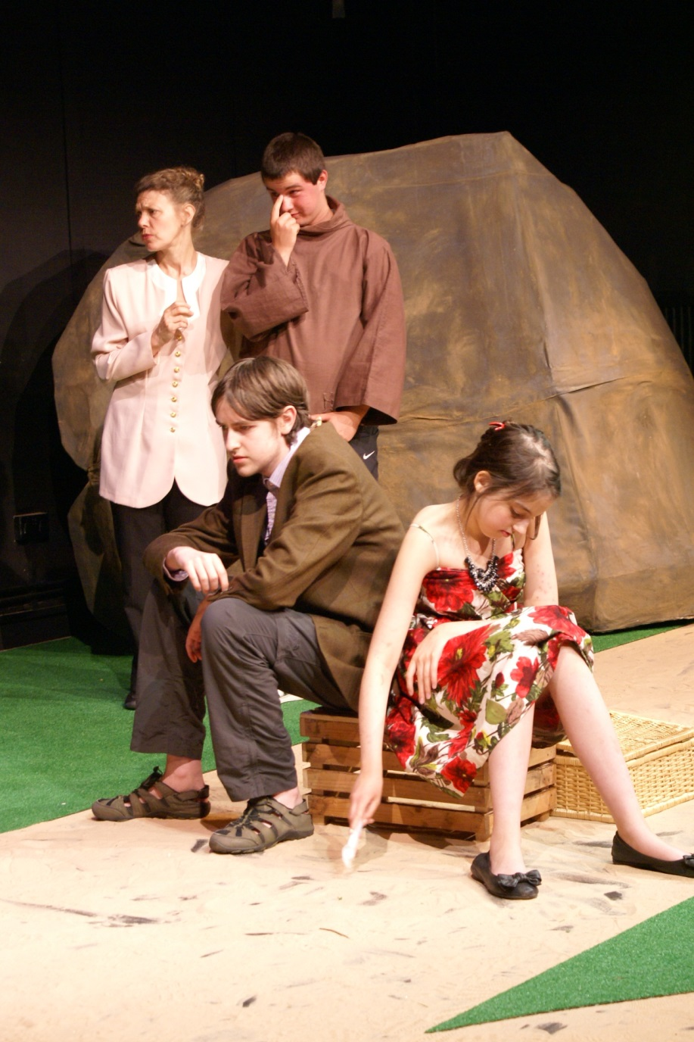
Neither potion nor plaything, but a provocation: teenagers’ engagement with myth
Cath Heinemeyer
York St John University / York Theatre Royal
www.storytellingwithadolescents.blogspot.co.uk
www.artsandnarrative.co.uk

Slide 2
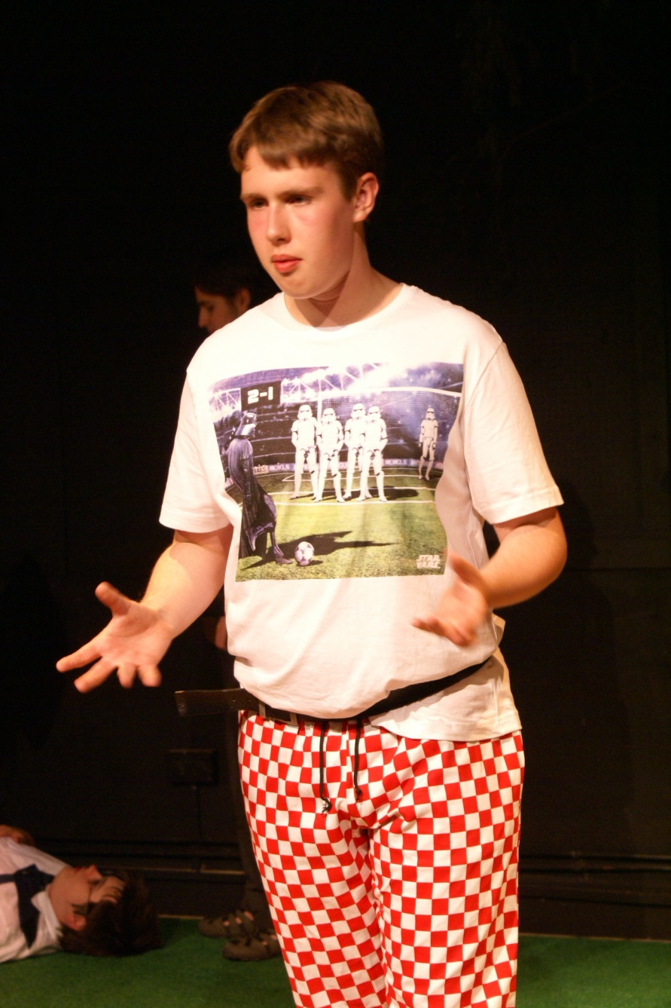
Whistle-stop intro to my research
Storyteller and educator focusing on sustainability and community
Practice-based PhD in storytelling with adolescents
Using mostly myth and folktale
AHRC-funded
In iCAN (York Theatre Royal + York St John University)
Storytelling for, with and by teenagers in long-term partnerships in
a school,
a mental health setting,
a drama club,
a youth club.

Slide 3
Pedagogy of storytelling
Participants
Storyteller
Transformative space of workshop
‘raw material’ – the story
transformation processes
new perspectives
Notes:
This is a very crude caricature of both cases, but it’s useful for raising questions.
Both drama practitioners and storytellers envisaged the workshop as a transformative space, in which raw material of some kind is transposed and explored and re-imagined by the group, meanings are shared, and something is created which the participants take away from the workshop at the end of the day. A new understanding or idea or skill or confidence.
The difference is, where does the raw material originate? In the case of the drama workshop, it’s largely ideas originating in the participants present. The facilitator receives this material and seeks set off processes whereby participants transform it, collectively and individually. Whereas in the storytelling workshop, it is a story coming from outside the workshop space, perhaps even from another culture or time period. This material then passes through the minds, experience and voice of each participant – it is transformed.
Of course drama practitioners may make use of texts and plays and other stimulus materials, storytellers also use activities to elicit young people’s own stories. But the essential difference stands. Why would we want to rely so heavily on material from beyond the workshop space?
These diagrams also suggest that the storyteller’s role is more pivotal/heroic than that of the drama facilitator (being the conduit for external material) but in fact they may then recede to a greater extent – they may exert less control over outcomes.
My diagram implies that the storyteller takes little role in this transformative process – she relies on participants to do it for themselves – and I think there is a small kernel of truth in this – I will return to it later.

Slide 4
Are myths wise? Neo-Jungian views
Gersie and King’s (1990) ‘structures’ for finding wisdom in myths/folktales in therapeutic storymaking groups; insistence on near word-perfect renditions
Clarissa Pinkola Estes (1996): rediscover the Wild Woman archetype
Robert Bly (1990): the Iron John myth as a guide to modern masculinity
Sense of ‘the right story’
Notes:
In fact Gersie, especially in her later book ‘Reflections on Therapeutic Storymaking’ in 1997, is a highly nuanced, insightful and responsive practitioner, not just rigidly following a methodology and believing in a single true understanding of each myth. ‘Storytelling in Education and Therapy’ is rather a how-to book for others following her methodology. However, the underlying belief which someone might take from her work is that a story can, if told sensitively and at the right moment, heal: cast ‘useful doubt’ on fixed narratives, suggest alternatives.
p.27: “Groups thrive on the constructive exploration of difference. The greatest possible tolerable variety is the material out of which well-functioning groups are fashioned.” Usually agreement within a group on the dominant meaning of a story, but acknowledgement of minority/alternative meanings. This starts to allow stories “to function as instruments in the process of social negotiation.”

Slide 5
Or are they historical artefacts?
Zipes (1995) : myth/fairytale historically situated.
Storyteller as cultural provocateur: to stimulate critical faculties and ‘creative maladjustment’
Brechtian desire to equip young people with ‘means of representation’ for subversive purposes.
Free experimentation with mythic elements to knock down stereotypes

Slide 6
Is myth a special category?
Bakhtin, ‘Epic and Novel’ (1941):
‘There is no place in the epic world for any openendedness, indecision, indeterminacy.’ (Morris 1994, p.182)
Epic world is ‘inaccessible to personal experience and does not permit an individual personal point of view or explanation.’ (p.183)
‘His view of himself coincides completely with others’ views of him – the view of his society (his community), the epic singer and the audience also coincide…’ (p.183)

Slide 7
The triangle of storytelling
Story
Story-listeners
Storyteller
retelling

Slide 8
The Twelve Wild Swans

Slide 9
Myth and the imagination
Lev Vygotsky (1967): creative imagination is a product of life experience; is combinatory
Walter Benjamin (1936): myth and story’s ‘lack of psychological shading’
Thus myth invites interpretation, filling in gaps using our own experience
Jacques Ranciere (2008): the Emancipated Spectator

Slide 10
My model is thus an oversimplification…
There is no ‘myth from outside’ – it is always a transposition to the context and ‘chronotope’
(Bakhtin )
Participants
Storyteller
Transformative space of workshop
‘raw material’ – the story
transformation processes
new perspectives
Notes:
This is a very crude caricature of both cases, but it’s useful for raising questions.
Both drama practitioners and storytellers envisaged the workshop as a transformative space, in which raw material of some kind is transposed and explored and re-imagined by the group, meanings are shared, and something is created which the participants take away from the workshop at the end of the day. A new understanding or idea or skill or confidence.
The difference is, where does the raw material originate? In the case of the drama workshop, it’s largely ideas originating in the participants present. The facilitator receives this material and seeks set off processes whereby participants transform it, collectively and individually. Whereas in the storytelling workshop, it is a story coming from outside the workshop space, perhaps even from another culture or time period. This material then passes through the minds, experience and voice of each participant – it is transformed.
Of course drama practitioners may make use of texts and plays and other stimulus materials, storytellers also use activities to elicit young people’s own stories. But the essential difference stands. Why would we want to rely so heavily on material from beyond the workshop space?
These diagrams also suggest that the storyteller’s role is more pivotal/heroic than that of the drama facilitator (being the conduit for external material) but in fact they may then recede to a greater extent – they may exert less control over outcomes.
My diagram implies that the storyteller takes little role in this transformative process – she relies on participants to do it for themselves – and I think there is a small kernel of truth in this – I will return to it later.

Slide 11
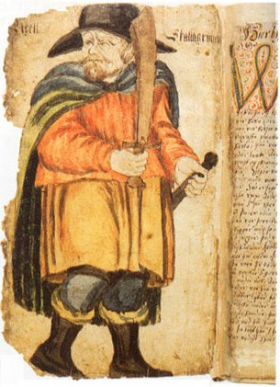
Myth as provocation
Myth from ‘absolute past’
Cognitive dissonance
Chronotope/context of telling

Slide 12
Neither potion nor plaything, but
Myth as valuable distilled human experience
- ‘raises the floor’
Myth as dialogic
co-production
- ‘made in the moment’
provocation

Slide 13
Neither preplanned route… Nor empty territory… But a provocative map

Slide 14
References
Benjamin, Walter (1936) ‘The Storyteller: Reflections on the Works of Nikolai Leskov’ in Hale, Dorothy J (ed.) (2006) The Novel: An Anthology of Criticism and Theory 1900-2000, Malden, Mass.: Blackwell Publishing.
Bly, Robert (1990) Iron John: A Book About Men. Da Capo Press Inc.
Gersie, A. and King, N. (1990) Storymaking in Education and Therapy. Sweden: Stockholm Institute of Education Press
Gersie, Alida (1997) Reflections on Therapeutic Storymaking: the use of stories in groups. London and Bristol, Pennsylvania: Jessica Kingsley Publishers.
Maguire, Tom (2015) Performing Story on the Contemporary Stage. London: Palgrave MacMillan
Morris, Pam (ed.) (1994) The Bakhtin Reader: Selected Writings of Bakhtin, Medvedev, Voloshinov. London: Arnold.
Pinkola Estes, Clarissa (1996) Women Who Run with the Wolves: Myths and Stories of the Wild Woman Archetype. Ballantine Books.
Ranciere, Jacques (2008) The Emancipated Spectator. London: Verso.
Vygotsky, Lev Semenovich (2004 (1967)) ‘Imagination and Creativity in Childhood’, Journal of Russian and East European Psychology 42:1, pp.7-97
Zipes, Jack (1995) Creative Storytelling: Building community, changing lives. London: Routledge.

